Slide 1

TBD Banking Application
Seth Evry
Elian Felix
AJ Barea

Slide 2

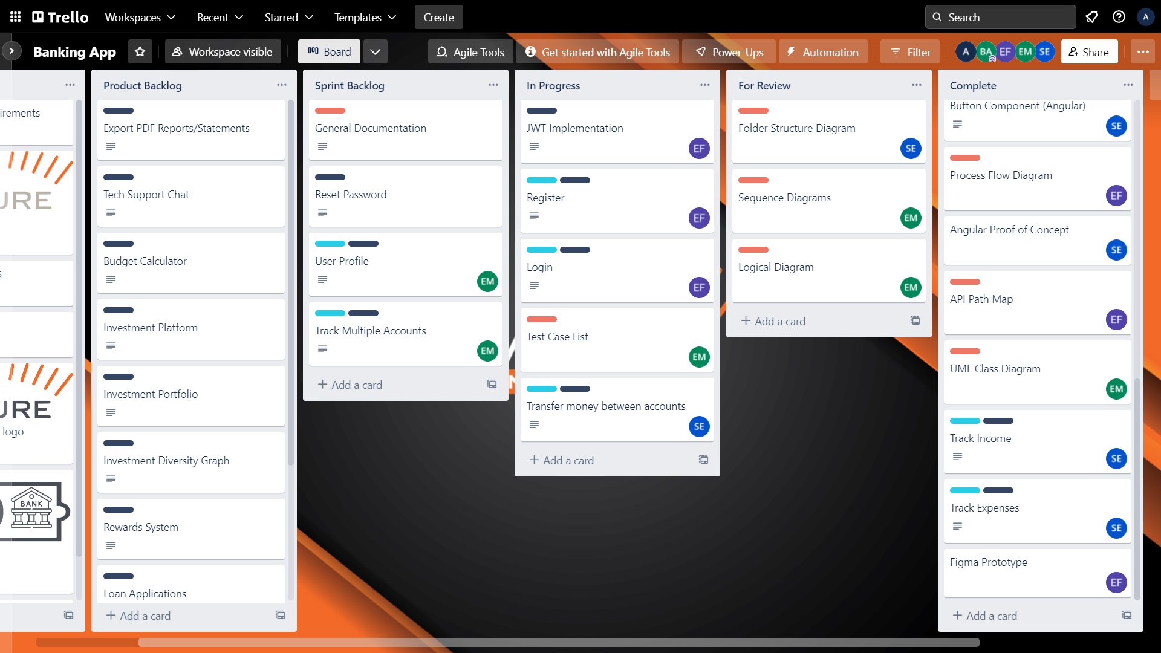
Agile/Scrum
Trello (kanban board) + Daily Stand-ups

Slide 3
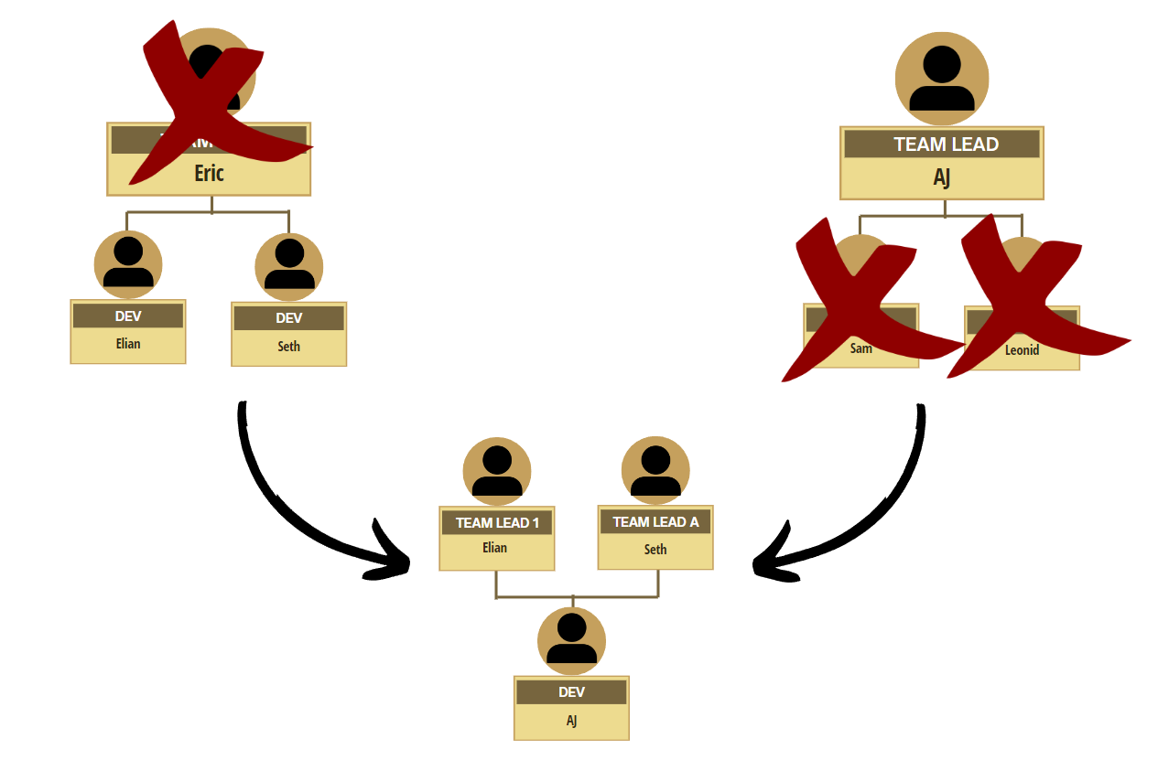
Team Structure

Slide 4
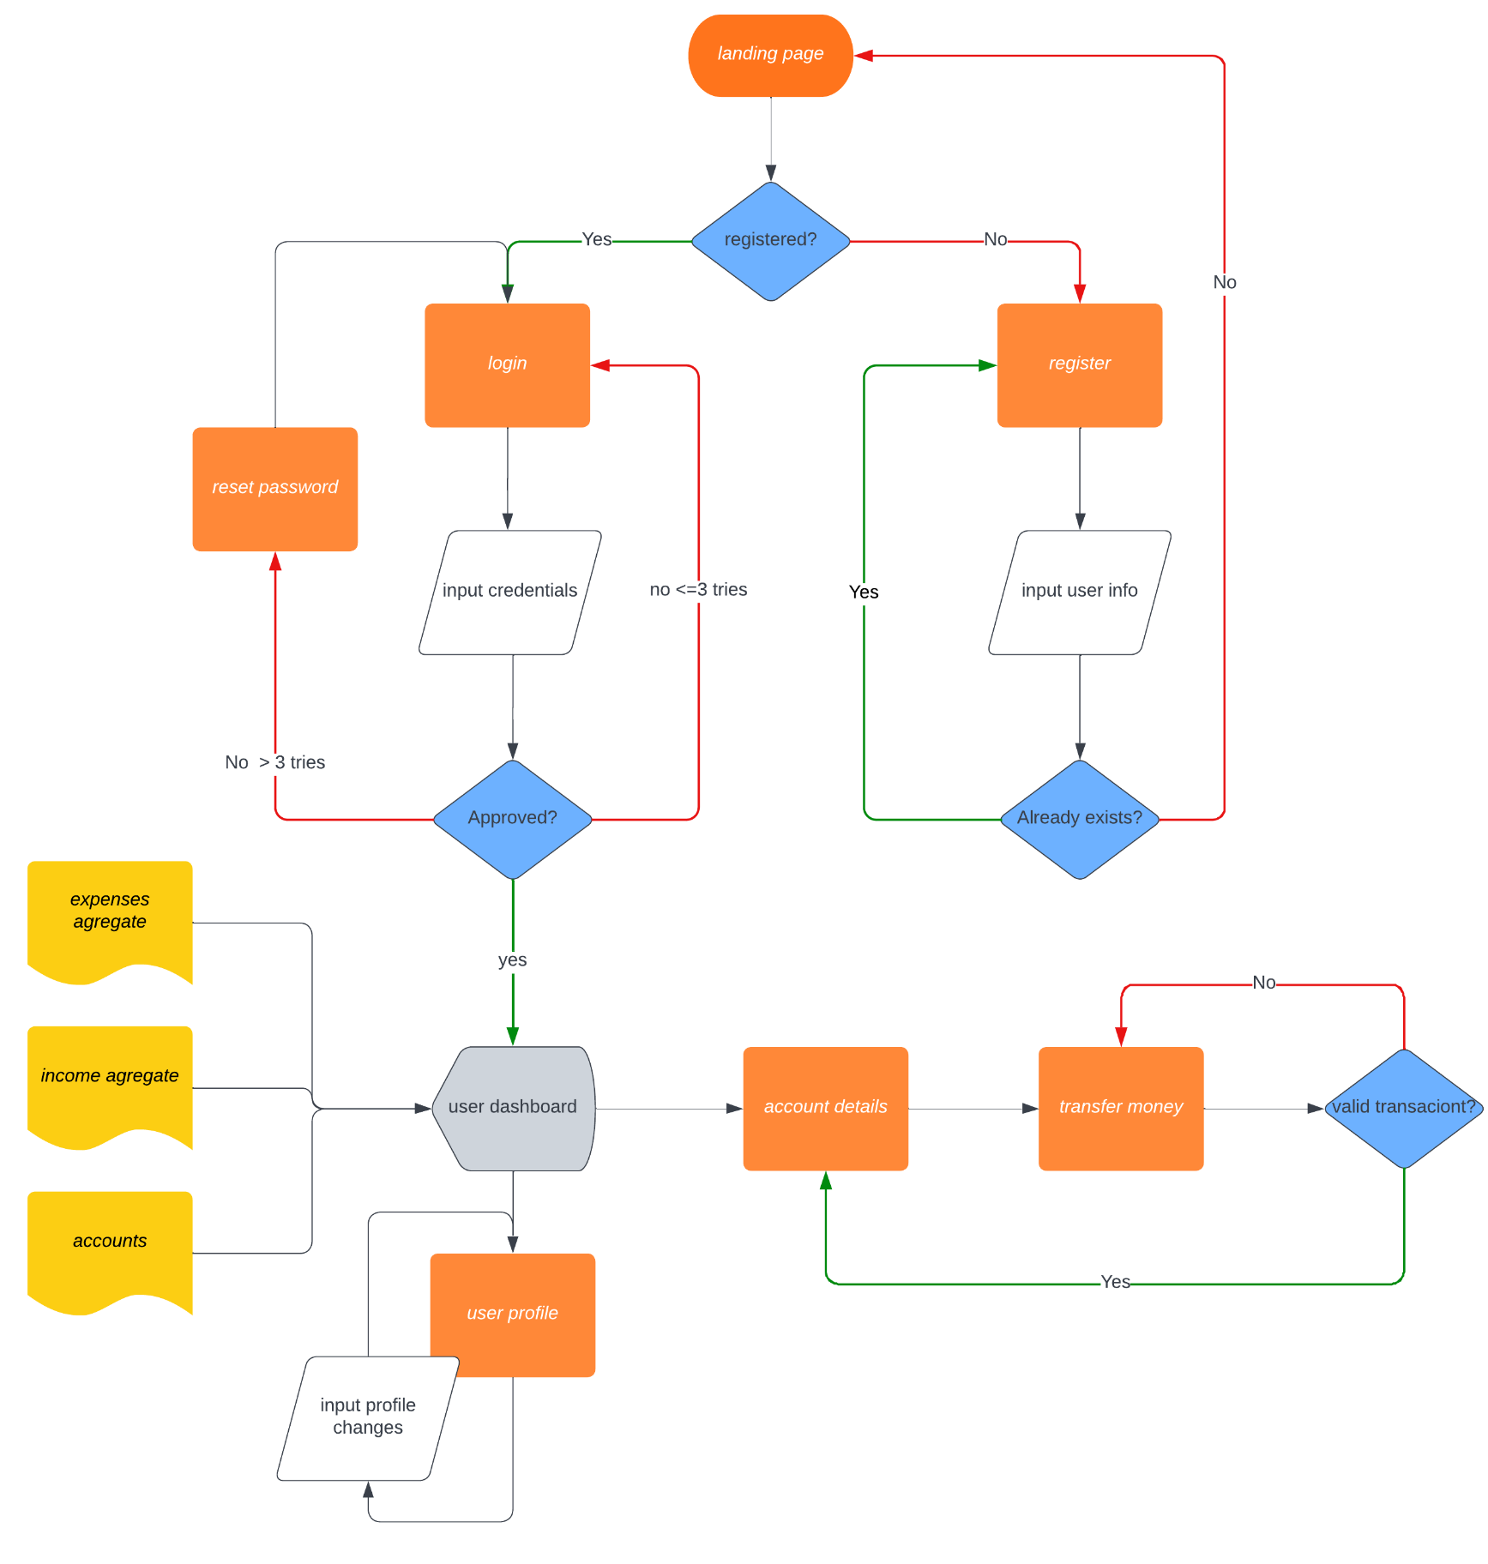
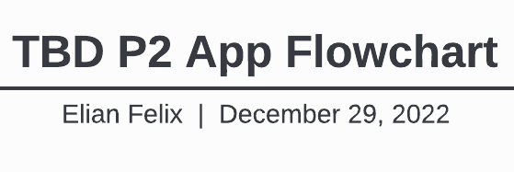
Planning: Flowchart

Slide 5
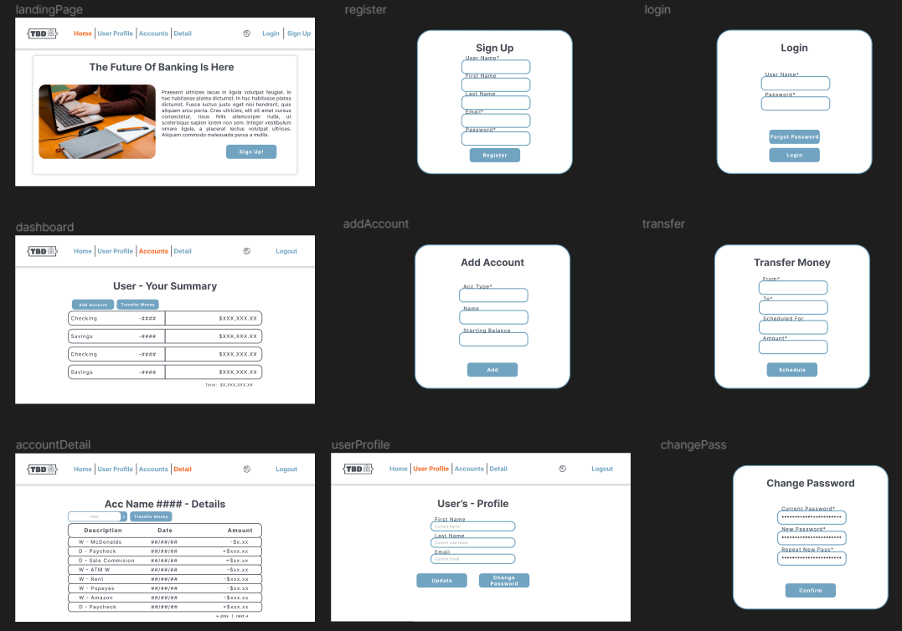
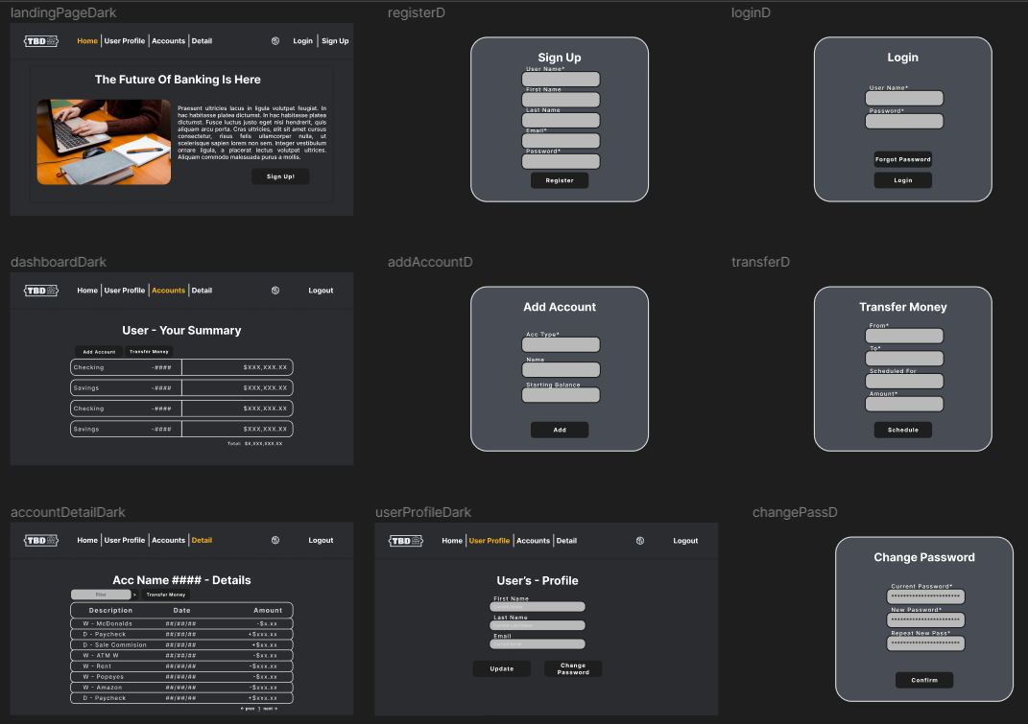
Planning: Figma
Light & Dark Mode Wireframing

Slide 6
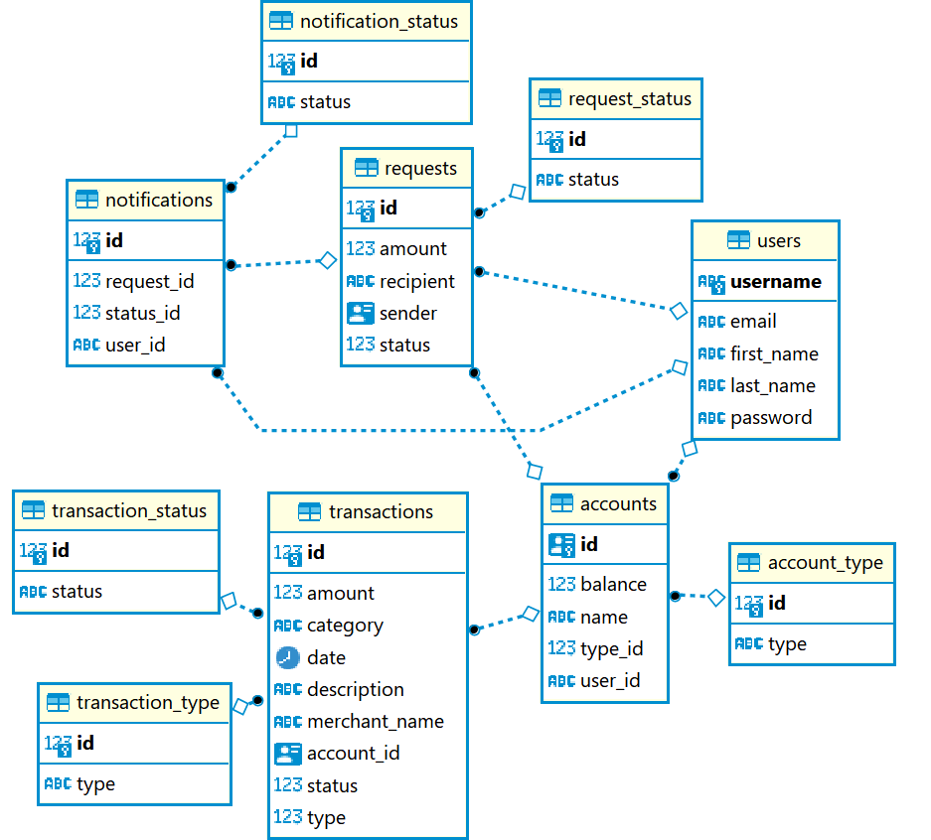
Planning: Entity Relationship Diagram

Slide 7









Technologies Utilized
Planning Tools
Figma
LucidChart
Trello
Google Slides
Canva
Dev Tools
Java
Spring Boot
Spring Web
Spring Data
Spring Security
Angular
TypeScript
PostgreSQL
Hibernate
JJwt
Angular Router
Angular Material
Bootstrap
RxJs
Maven
npm
GitHub
Karma
Jasmine
Node.js
Postman
Docker
Java Faker Library
Notes:
Planning tools should be with Agile methodology Split into 2: Backend / Frontend Dev Tools

Slide 8
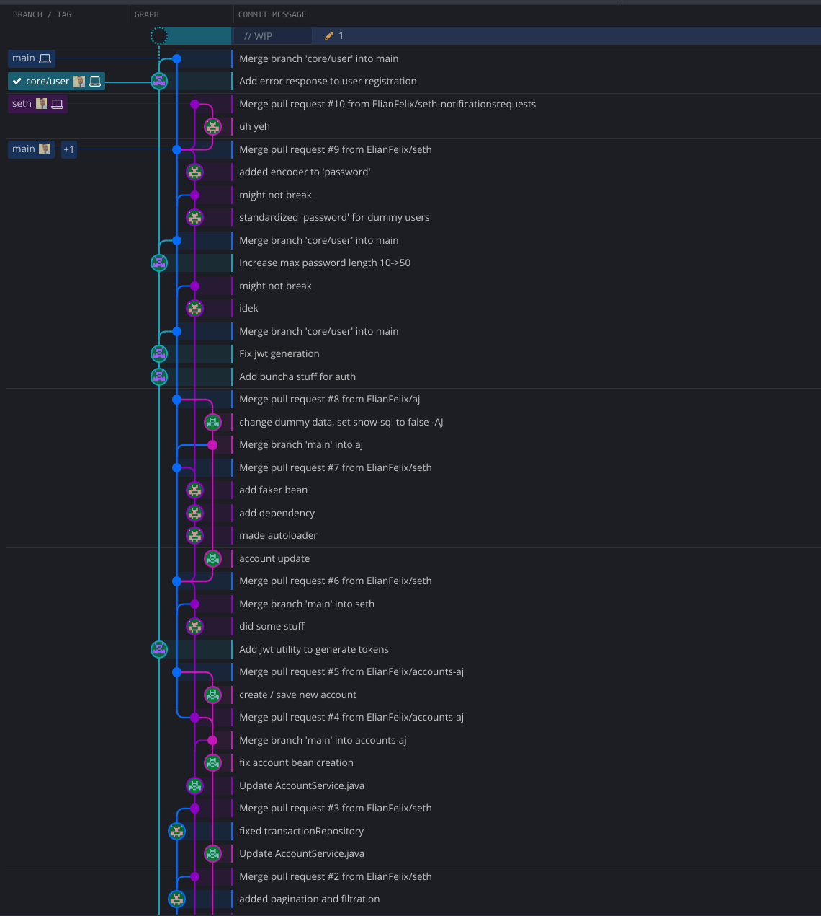
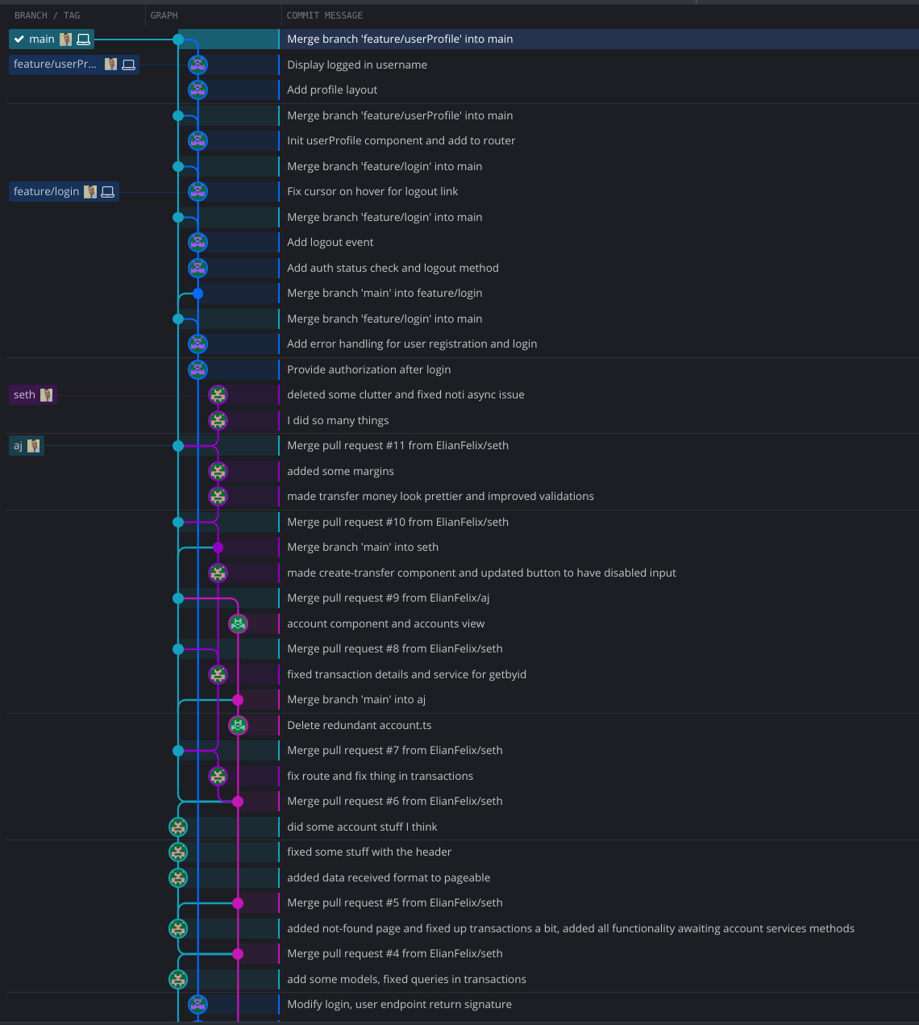
Branching Strategy
Frontend Branching
Backend Branching

Slide 9
Features Implemented
Header
Footer
Dark Mode Switch
Register Page
Login Page
Landing Page
User Profile
Update Profile
Track Expenses
Track Income
Send Money
Request Money
Track Multiple Accounts
Transfer Money Between Accounts
JSON Web Token
Authentication
Authorization
Notifications

Slide 10
Challenges Faced
Team Restructuring
Spring Security
Refreshing the account balances after a transfer between accounts

Slide 11
Demo
TBD Bank Demonstration

Slide 12
Future Sprint Plans
Email Alerts
Budget Calculator
Loan Applications
‘Money Request Approved’ Notification
Monthly Account Statements PDF

